Slide 1

Mastering Terraform: Infrastructure as Code
Unlock the power of automated infrastructure management.
This presentation will guide cloud engineers and DevOps practitioners through the fundamentals of Terraform, highlighting its capabilities and best practices for modern cloud environments.

Slide 2

What is Terraform?
Terraform is an open-source Infrastructure as Code (IaC) tool developed by HashiCorp. It allows you to define and provision data center infrastructure using a high-level configuration language, abstracting away complex API calls and manual processes.
Defines infrastructure using configuration files.
Manages resources across multiple cloud providers and on-prem solutions.
Facilitates collaboration and version control for infrastructure.

Slide 3


A Brief History and Evolution
2014 Release
Initial open-source launch
Multi-cloud
Support for multiple providers
Agentless Design
No agents required for provisioning
Terraform was first released in 2014, quickly gaining traction for its innovative approach to infrastructure provisioning. From its inception, it was designed with multi-cloud support in mind, allowing engineers to manage diverse environments with a single tool. Its agentless architecture simplified deployment and reduced overhead, making it a preferred choice for many organizations.

Slide 4
Terraform vs. Configuration Management Tools
Understanding the distinction between IaC and configuration management is crucial.
Terraform
Declarative
Infrastructure Provisioning
Declarative vs. Imperative
Imperative: Focuses on how to achieve a desired state (e.g., "install Apache, then start it").
Declarative: Focuses on what the desired state should be (e.g., "Apache should be installed and running").
Ansible
Imperative
Configuration Management
Chef/Puppet
Declarative
Configuration Management
Terraform adopts a declarative approach, which is often preferred for infrastructure as it simplifies state management and ensures idempotency.

Slide 5

Why Choose Terraform?
Cloud-Agnostic
Works with major cloud providers (AWS, Azure, GCP) and many other services, offering unparalleled flexibility.
State Management
Maintains a state file to track the current infrastructure, ensuring accurate updates and preventing configuration drift.
Dependency Graph
Automatically understands and manages resource dependencies, provisioning resources in the correct order.
Immutable Infrastructure
Promotes building new infrastructure rather than modifying existing, leading to more stable and predictable environments.

Slide 6
Key Benefits of Terraform
Version-Controlled Infrastructure
Reusable Modules
Automation & Consistency
Encapsulate common infrastructure patterns into reusable modules, promoting consistency and accelerating development.
Automate infrastructure provisioning, reducing manual errors and ensuring consistent deployments across environments.
Treat your infrastructure definitions like code, enabling versioning, collaboration, and rollbacks.
These benefits collectively lead to faster deployments, improved reliability, and reduced operational costs.

Slide 7


Getting Started: Installation & Verification
To begin using Terraform, you'll need to install the Terraform CLI binary on your local machine. HashiCorp provides detailed installation guides for various operating systems.
Installation Steps:
Download the appropriate package for your OS from hashicorp.com/downloads/terraform
Unzip the package and move the Terraform executable to a directory in your system's PATH (e.g., /usr/local/bin).
Always download Terraform from the official HashiCorp website to ensure authenticity and access the latest features and security updates.
Verify Installation:
Open your terminal or command prompt and run:
terraform version
This command should output the installed Terraform version, confirming a successful installation.

Slide 8
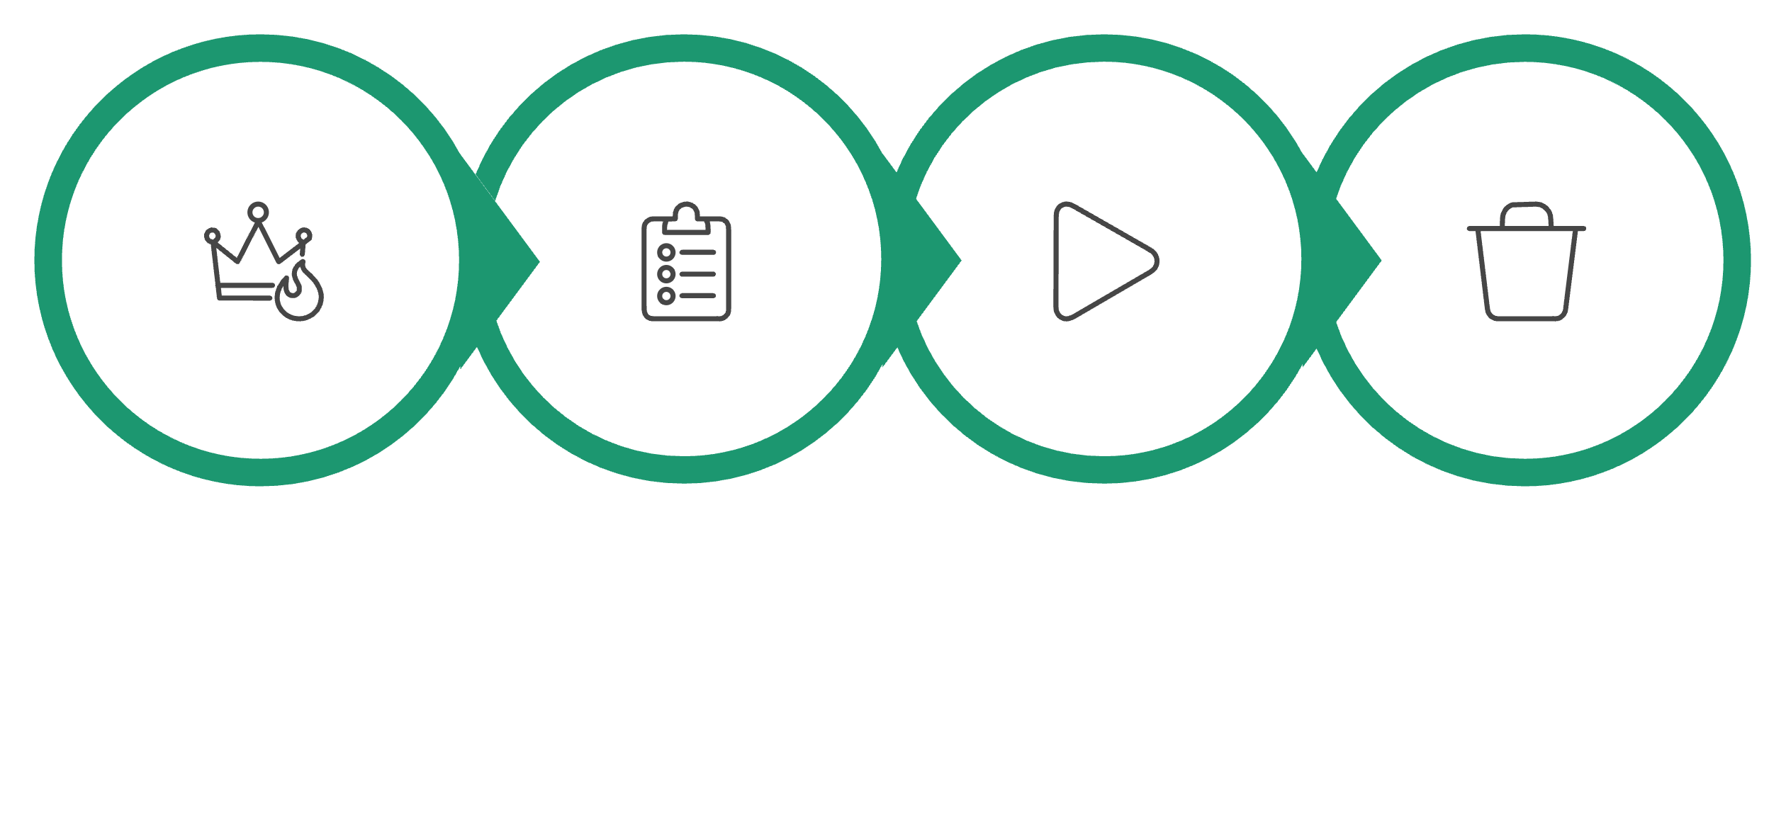
The Terraform Workflow Lifecycle
Initialize
Plan
Apply
Destroy
Terraform follows a clear and consistent workflow for managing infrastructure:
terraform init: Initializes a working directory containing Terraform configuration files. It downloads necessary providers and modules.
terraform plan: Generates an execution plan, showing what actions Terraform will take to achieve the desired state. This is a critical step for review.
terraform apply: Executes the actions proposed in the plan, provisioning or updating your infrastructure.
terraform destroy: Tears down all resources managed by the current Terraform configuration. Use with caution!

Slide 9

Core Components: Providers, Resources, Variables & Outputs
Providers
Variables
Terraform relies on providers to interact with various cloud services (e.g., aws, azurerm, google) and other APIs. Providers abstract the complexity of interacting with these services.
Variables allow you to parameterize your configurations, making them reusable and dynamic. They provide a way to input values into your Terraform code.
Resources
Outputs
Resources are the fundamental building blocks of your infrastructure (e.g., virtual machines, databases, networks). Each resource block describes one or more infrastructure objects.
Outputs expose specific values from your infrastructure, such as IP addresses or connection strings, making them accessible to other Terraform configurations or external tools.

Slide 10
Advanced Concepts: Modules & State Management
Terraform Modules
State File (terraform.tfstate)
Modules are self-contained Terraform configurations that can be reused across different projects. They encapsulate infrastructure components, promoting modularity and organization.
The state file records the mapping between your configuration and the real-world infrastructure. It's crucial for Terraform to understand what exists and how to modify it.
Remote State: For team collaboration and production environments, storing the state file remotely (e.g., AWS S3 + DynamoDB) is essential for locking and consistency.
terraform fmt & validate: Use terraform fmt to automatically format your code and terraform validate to check for syntax and configuration errors before applying.
modules/
└── ec2/
├── main.tf
├── variables.tf
└── outputs.tf
This structure allows you to define a standardized EC2 instance configuration once and reuse it many times.

